Slide 1
Computer Security
by
Seth Alornyo (PhD)

Slide 2
Disclaimer!
The slides are partially collected from the Internet for educational purpose only. I do not claim any credit for them and the copyrights belong to the original authors

Slide 3
Three Cybersecurity Dimension

Slide 4
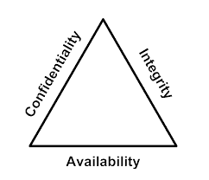
The Three Dimensions of the Cybersecurity Cube The Three Dimensions
The Principles of Security
The first dimension of the cybersecurity cube identifies the goals to protect the cyber world. The goals identified in the first dimension are the foundational principles of the cybersecurity world.
These three principles are confidentiality, integrity and availability.
The principles provide focus and enable cybersecurity specialists to prioritize actions in protecting the cyber world.
Use the acronym CIA to remember these three principles.
The States of Data
The cyber world is a world of data; therefore, cybersecurity specialists focus on protecting data. The second dimension of the cybersecurity cube focuses on the problems of protecting all of the states of data in the cyber world. Data has three possible states:
1) Data at rest or in storage 2) Data in transit 3) Data in process

Slide 5
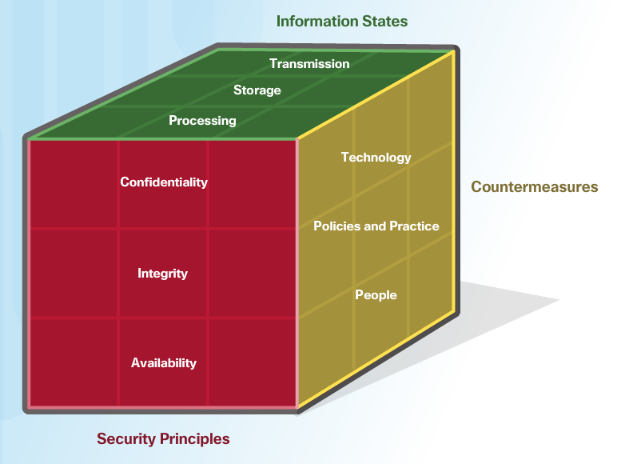
The Three Dimensions of the Cybersecurity Cube The Three Dimensions (Cont.)
Cybersecurity Safeguards
The third dimension of the cybersecurity sorcery cube defines the types of powers used to protect the cyber world. The sorcery cube identifies the three types of powers:
Technologies - devices, and products available to protect information systems and fend off cyber criminals.
Policies and Practices - procedures, and guidelines that enable the citizens of the cyber world to stay safe and follow good practices.
People - Aware and knowledgeable about their world and the dangers that threaten their world.

Slide 6
CIA TRIAD

Slide 7
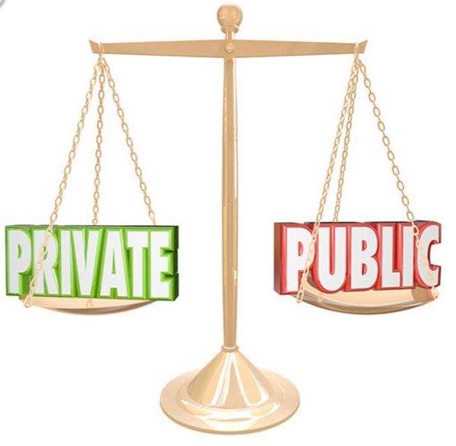
CIA TRIAD Confidentiality
The Principle of Confidentiality
Confidentiality prevents the disclosure of information to unauthorized people, resources and processes. Another term for confidentiality is privacy.
Organizations need to train employees about best practices in safeguarding sensitive information to protect themselves and the organization from attacks.
Methods used to ensure confidentiality include data encryption, authentication, and access control.
Protecting Data Privacy
Organizations collect a large amount of data and much of this data is not sensitive because it is publicly available, like names and telephone numbers.
Other data collected, though, is sensitive. Sensitive information is data protected from unauthorized access to safeguard an individual or an organization.

Slide 8
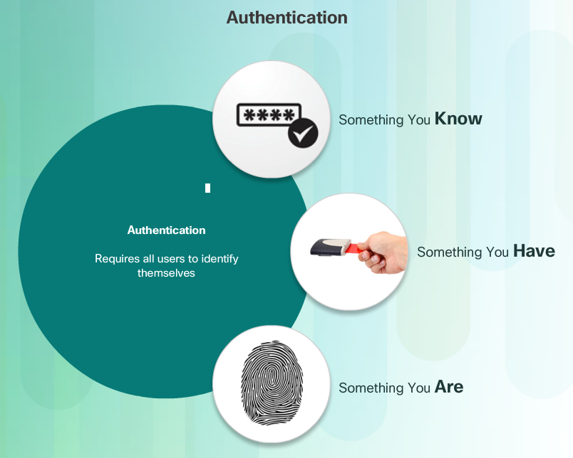
CIA TRIAD Confidentiality (Cont.)
Controlling Access
Access control defines a number of protection schemes that prevent unauthorized access to a computer, network, database, or other data resources. The concepts of AAA involve three security services: Authentication, Authorization and Accounting. Authentication verifies the identity of a user to prevent unauthorized access. Users prove their identity with a username or I.D.
Authorization services determine which resources users can access, along with the operations that users can perform. Authorization can also control when a user has access to a specific resource.
Accounting keeps track of what users do, including what they access, the amount of time they access resources, and any changes made.

Slide 9
CIA TRIAD Confidentiality (Cont.)
Confidentiality and privacy seem interchangeable, but from a legal standpoint, they mean different things.
Most privacy data is confidential, but not all confidential data is private. Access to confidential information occurs after confirming proper authorization. Financial institutions, hospitals, medical professionals, law firms, and businesses handle confidential information.
Confidential information has a non-public status. Maintaining confidentiality is more of an ethical duty.
Privacy is the appropriate use of data. When organizations collect information provided by customers or employees, they should only use that data for its intended purpose.

Slide 10
CIA TRIAD Integrity
Principle of Data Integrity
Integrity is the accuracy, consistency, and trustworthiness of data during its entire life cycle.
Another term for integrity is quality.
Methods used to ensure data integrity include hashing, data validation checks, data consistency checks, and access controls.
Need for Data Integrity
The need for data integrity varies based on how an organization uses data. For example, Facebook does not verify the data that a user posts in a profile.
A bank or financial organization assigns a higher importance to data integrity than Facebook does. Transactions and customer accounts must be accurate.
Protecting data integrity is a constant challenge for most organizations. Loss of data integrity can render entire data resources unreliable or unusable.
Integrity Checks
An integrity check is a way to measure the consistency of a collection of data (a file, a picture, or a record). The integrity check performs a process called a hash function to take a snapshot of data at an instant in time.

Slide 11
CIA TRIAD Availability
Data availability is the principle used to describe the need to maintain availability of information systems and services at all times. Cyberattacks and system failures can prevent access to information systems and services.
Methods used to ensure availability include system redundancy, system backups, increased system resiliency, equipment maintenance, up-to-date operating systems and software, and plans in place to recover quickly from unforeseen disasters.
High availability systems typically include three design principles: eliminate single points of failure, provide for reliable crossover, and detect failures as they occur.
Organizations can ensure availability by implementing the following:
Equipment maintenance
OS and system updates
Test backups
Plan for disasters
Implement new technologies
Monitor unusual activity
Test to verify availability

Slide 12

States of Data Data at Rest
Stored data refers to data at rest. Data at rest means that a type of storage device retains the data when no user or process is using it.
A storage device can be local (on a computing device) or centralized (on the network). A number of options exist for storing data.
Direct-attached storage (DAS) is storage connected to a computer. A hard drive or USB flash drive is an example of direct-attached storage.

Slide 13
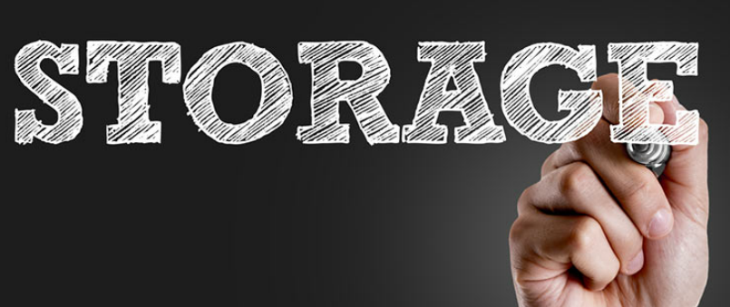
States of Data Data at Rest (Cont.)
Redundant array of independent disks (RAID) uses multiple hard drives in an array, which is a method of combining multiple disks so that the operating system sees them as a single disk. RAID provides improved performance and fault tolerance.
A network attached storage (NAS) device is a storage device connected to a network that allows storage and retrieval of data from a centralized location by authorized network users. NAS devices are flexible and scalable, meaning administrators can increase the capacity as needed.
A storage area network (SAN) architecture is a network-based storage system. SAN systems connect to the network using high-speed interfaces allowing improved performance and the ability to connect multiple servers to a centralized disk storage repository.

Slide 14
States of Data Data In Transit
Data transmission involves sending information from one device to another. There are numerous methods to transmit information between devices including:
Sneaker net – uses removable media to physically move data from one computer to another
Wired networks – uses cables to transmit data
Wireless networks – uses the airwaves to transmit data
The protection of transmitted data is one of the most challenging jobs of a cybersecurity professional. The greatest challenges are:
Protecting data confidentiality – cyber criminals can capture, save and steal data in-transit.
Protecting data integrity – cyber criminals can intercept and alter data in-transit.
Protecting data availability - cyber criminals can use rogue or unauthorized devices to interrupt data availability.

Slide 15
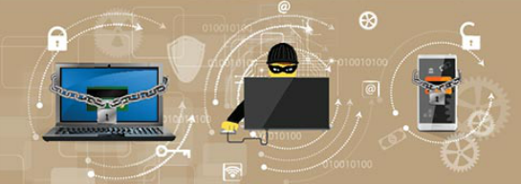
States of Data Data In Process
The third state of data is data in process. This refers to data during initial input, modification, computation, or output.
Protection of data integrity starts with the initial input of data.
Organizations use several methods to collect data, such as manual data entry, scanning forms, file uploads, and data collected from sensors.
Each of these methods pose potential threats to data integrity.
Data modification refers to any changes to the original data such as users manually modifying data, programs processing and changing data, and equipment failing resulting in data modification.
Processes like encoding/decoding, compression/decompression and encryption/decryption are all examples of data modification. Malicious code also results in data corruption.

Slide 16
COUNTERMEASURE
1. Technology (Software, hardware , Network, and Cloud)
2. Implementing Cybersecurity Education and Training
3. Cybersecurity Policies and Procedures

Slide 17
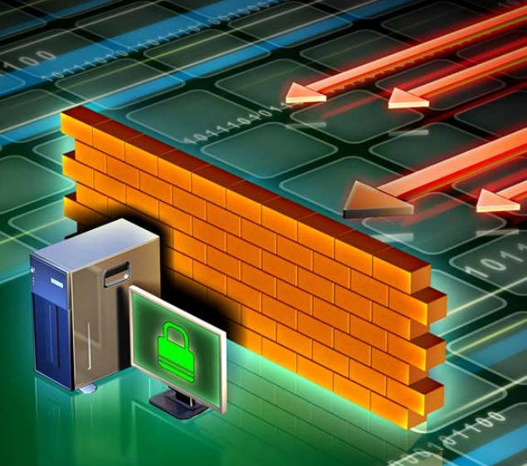
Cybersecurity Countermeasures Technologies
Software-based Technology Safeguards
Software safeguards include programs and services that protect operating systems, databases, and other services operating on workstations, portable devices, and servers. There are several software-based technologies used to safeguard an organization’s assets.
Hardware-based Technology Safeguards
Hardware based technologies are appliances that are installed within the network faculties. They can include: Firewall appliances, Intrusion Detection Systems (IDS),Intrusion Prevention Systems (IPS) and Content filtering systems.

Slide 18
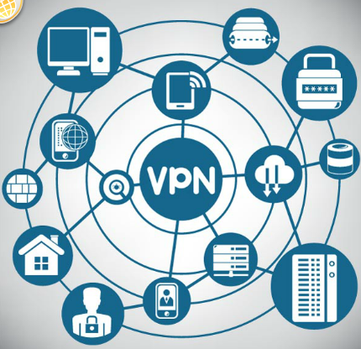
Cybersecurity Countermeasures Technologies
Network-based Technology Safeguards
Technological countermeasures can also include network-based technologies.
Virtual Private Network (VPN) is a secure virtual network that uses the public network (i.e., the Internet). The security of a VPN lies in the encryption of packet content between the endpoints that define the VPN.
Network access control (NAC) requires a set of checks before allowing a device to connect to a network. Some common checks include up-to-data antivirus software or operating system updates installed.
Wireless access point security includes the implementation of authentication and encryption.

Slide 19

Cybersecurity Countermeasures Technologies
Cloud-based Technology Safeguards
Technological countermeasures now also include cloud-based technologies. Cloud-based technologies shift the technology component from the organization to the cloud provider.
Software as a Service (SaaS) allows users to gain access to application software and databases. Cloud providers manage the infrastructure. Users store data on the cloud provider’s servers.
Infrastructure as a Service (IaaS) provides virtualized computing resources over the Internet. The provider hosts the hardware, software, servers, and storage components.
Virtual security appliances run inside a virtual environment with a pre-packaged, hardened operating system running on virtualized hardware.

Slide 20

Cybersecurity Countermeasures Implementing Cybersecurity Education and Training
A security awareness program is extremely important for an organization. An employee may not be purposefully malicious but just unaware of what the proper procedures are.
There are several ways to implement a formal training program:
Make security awareness training a part of the employee’s onboarding process
Tie security awareness to job requirements or performance evaluations
Conduct in-person training sessions
Complete online courses
Security awareness should be an ongoing process since new threats and techniques are always on the horizon.

Slide 21
Cybersecurity Countermeasures Cybersecurity Policies and Procedures
A security policy is a set of security objectives for a company that includes rules of behavior for users and administrators and specifies system requirements. These objectives, rules, and requirements collectively ensure the security of a network, the data, and the computer systems within an organization.
Standards help an IT staff maintain consistency in operating the network. Standards provide the technologies that specific users or programs need in addition to any program requirements or criteria that an organization must follow.
Guidelines are a list of suggestions on how to do things more efficiently and securely. They are similar to standards, but are more flexible and are not usually mandatory. Guidelines define how standards are developed and guarantee adherence to general security policies.
Procedure documents are longer and more detailed than standards and guidelines. Procedure documents include implementation details that usually contain step-by-step instructions and graphics.

Slide 22
Cyber World Powers and Standards.
The ISO Model and Standards:
The International Organization for Standardization (ISO)/International Electrotechnical Commission (IEC) developed a comprehensive, Cybersecurity Authority, Ghana Data Protection Act… etc.
This was one of the guiding standard and model for developing the GHS Information Security Policy

Slide 23
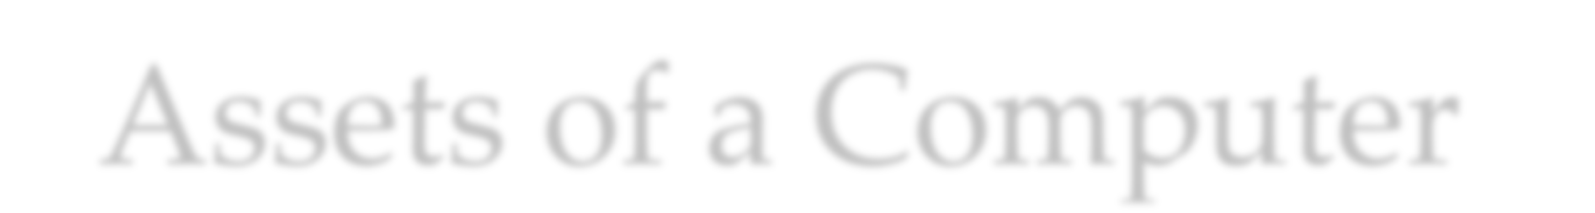
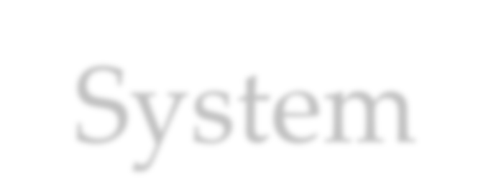
Assets of a Computer System
Hardware
Software
Data
Communication facilities and networks
© 2016 Pearson Education, Inc., Hoboken, NJ. All rights reserved.

Slide 24




Countermeasures
Means used to deal with security attacks
Prevent
Detect
Recover
Residual vulnerabilities may remain
Goal is to minimize residual level of risk to the assets
May itself introduce new vulnerabilities
© 2016 Pearson Education, Inc., Hoboken, NJ. All rights reserved.

Slide 25
Table 1.2
Threat Consequence | Threat Action (Attack)
Unauthorized Disclosure A circumstance or event whereby an entity gains access to data for which the entity is not authorized. | Exposure: Sensitive data are directly released to an unauthorized entity. Interception: An unauthorized entity directly accesses sensitive data traveling between authorized sources and destinations. Inference: A threat action whereby an unauthorized entity indirectly accesses sensitive data (but not necessarily the data contained in the communication) by reasoning from characteristics or byproducts of communications. Intrusion: An unauthorized entity gains access to sensitive data by circumventing a system's security protections.
Deception A circumstance or event that may result in an authorized entity receiving false data and believing it to be true. | Masquerade: An unauthorized entity gains access to a system or performs a malicious act by posing as an authorized entity. Falsification: False data deceive an authorized entity. Repudiation: An entity deceives another by falsely denying responsibility for an act.
Disruption A circumstance or event that interrupts or prevents the correct operation of system services and functions. | Incapacitation: Prevents or interrupts system operation by disabling a system component. Corruption: Undesirably alters system operation by adversely modifying system functions or data. Obstruction: A threat action that interrupts delivery of system services by hindering system operation.
Usurpation A circumstance or event that results in control of system services or functions by an unauthorized entity. | Misappropriation: An entity assumes unauthorized logical or physical control of a system resource. Misuse: Causes a system component to perform a function or service that is detrimental to system security.
Threat Consequences, and the
Types of Threat Actions That Cause Each Consequence
Based on
RFC 4949
**Table is on page 20 in the textbook.
© 2016 Pearson Education, Inc., Hoboken, NJ. All rights reserved.

Slide 26
Table 1.3
Computer and Network Assets, with Examples of Threats
 | Availability | Confidentiality | Integrity
Hardware | Equipment is stolen or disabled, thus denying service. | An unencrypted CD- ROM or DVD is stolen.
Software | Programs are deleted, denying access to users. | An unauthorized copy of software is made. | A working program is modified, either to cause it to fail during execution or to cause it to do some unintended task.
Data | Files are deleted, denying access to users. | An unauthorized read of data is performed. An analysis of statistical data reveals underlying data. | Existing files are modified or new files are fabricated.
 | Messages are destroyed |  | Messages are modified,
Communication | or deleted. | Messages are read. The | delayed, reordered, or
Lines and Networks | Communication lines or networks are | traffic pattern of messages is observed. | duplicated. False messages are
 | rendered unavailable. |  | fabricated.

Slide 27
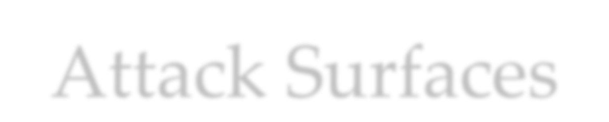







Consist of the reachable and exploitable vulnerabilities in a system
Examples:
Code that processes incoming data, email, XML, office documents, and industry-specific custom data exchange formats
An employee with access to sensitive information vulnerable to a social engineering attack
Open ports on outward facing Web and other servers, and code listening on those ports
Services available on the inside of a firewall
Interfaces, SQL, and Web forms
© 2016 Pearson Education, Inc., Hoboken, NJ. All rights reserved.

Slide 28
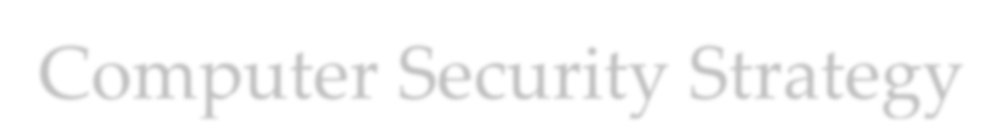
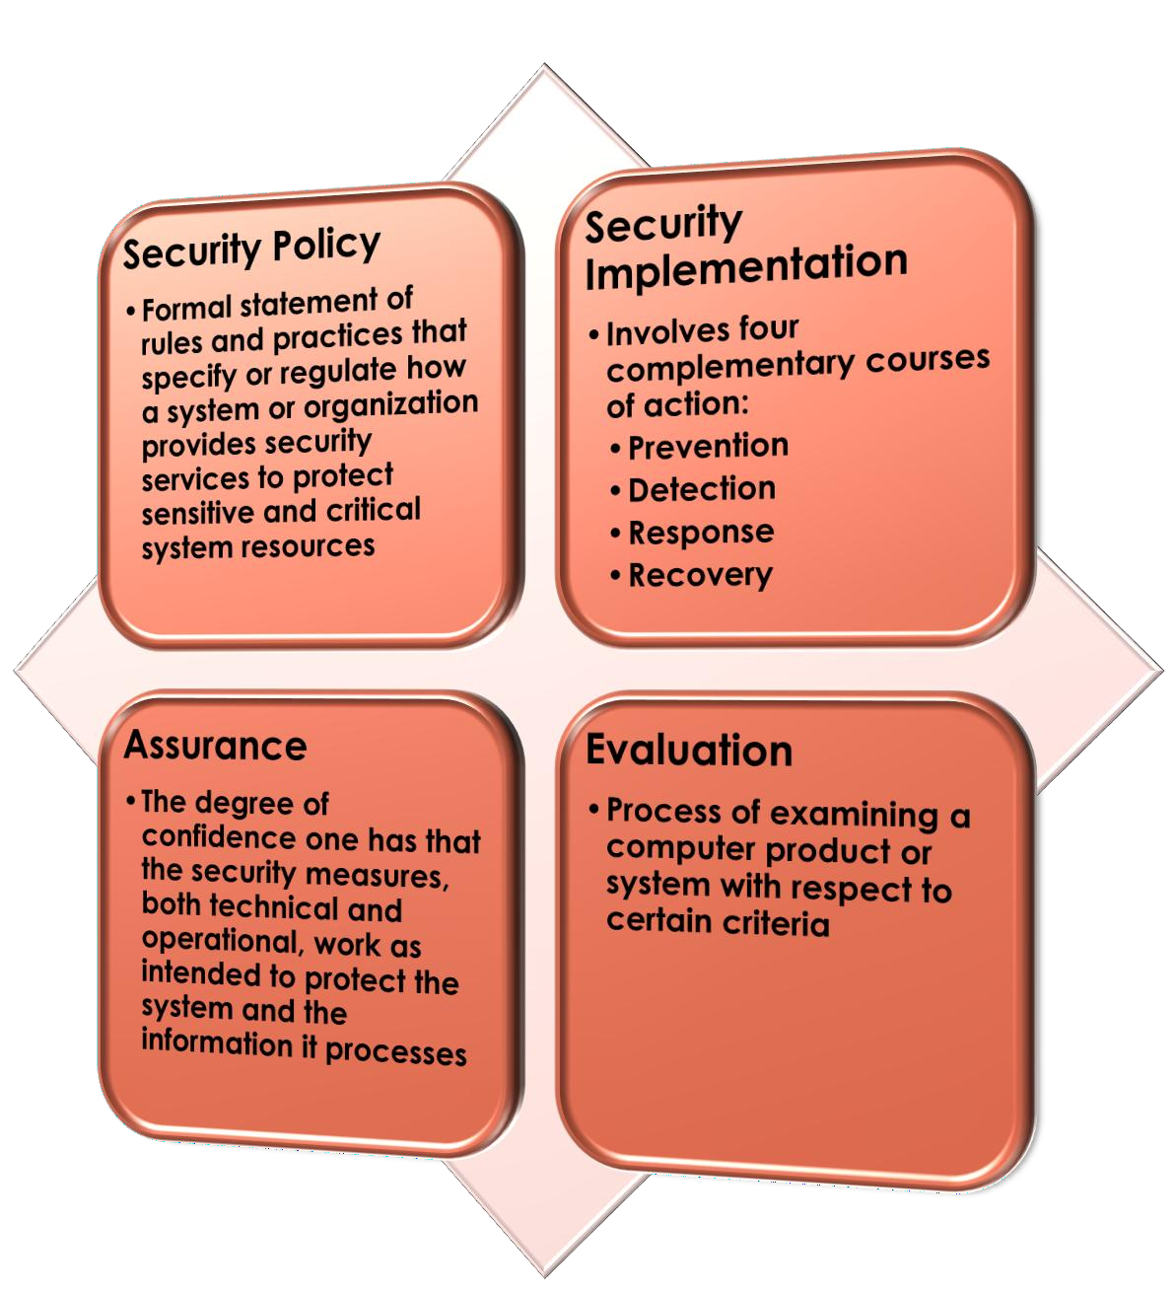
© 2016 Pearson Education, Inc., Hoboken, NJ. All rights reserved.

